Slide 2
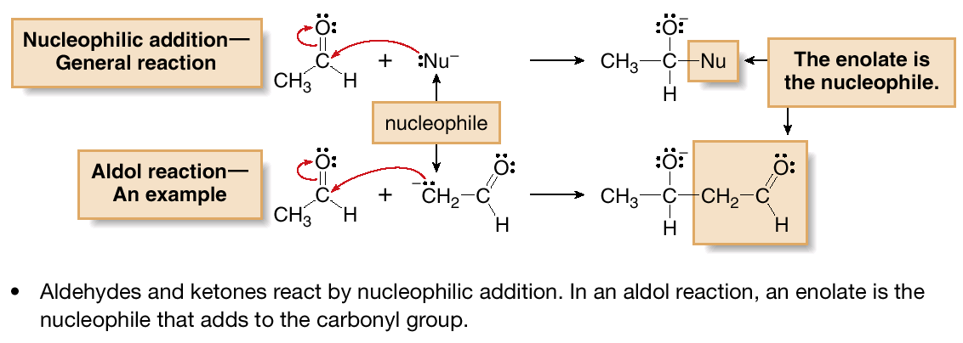
Carbonyl Condensation Reactions
The Aldol Reaction
Recall that the characteristic reaction of aldehydes and ketones is nucleophilic addition. An aldol reaction is a nucleophilic addition in which an enolate is the nucleophile.
Figure 24.1
The aldol reaction—An example
of nucleophilic addition

Slide 3
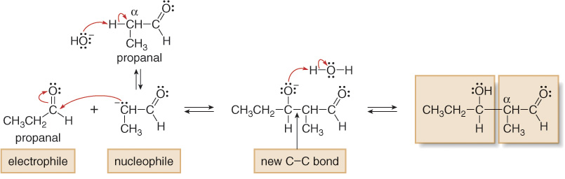
Carbonyl Condensation Reactions
The Aldol Reaction
A second example of an aldol reaction is shown with propanal as the starting material. The two molecules of the aldehyde that participate in the aldol reaction react in opposite ways.

Slide 4
Carbonyl Condensation Reactions
The Aldol Reaction
A second example of an aldol reaction is shown with propanal as the starting material. The two molecules of the aldehyde that participate in the aldol reaction react in opposite ways.

